Slide 1



Project on
Indian Stock market analysis from Groww.in
(5-Day Snapshot: Feb 17–23, 2026)

Slide 2
INRODUCTION
•Fast-growing Indian investment platform.
•Founded in 2016.
•Initially started as a mutual fund investment platform.
•Later expanded to stock trading and other financial services.
•Offers zero-commission equity delivery.
•Known for its simple and user-friendly interface.

Slide 3

BUSINESS PROBLEM
The stock market contains thousands of companies across different industries.
Investors need insights to identify large companies, profitable sectors, and investment opportunities.
This project analyzes financial data to discover sector dominance, profitability trends, and valuation patterns.

Slide 4

OBJECTIVE
Scrape stock data from Groww.
Extract company fundamentals & price metrics.
Clean financial data.
Split dataset:
1. Fundamentals → Long-term analysis
2. Price data → 5-day short-term analysis
Perform sector & market trend analysis.
Visualize key insights.

Slide 5
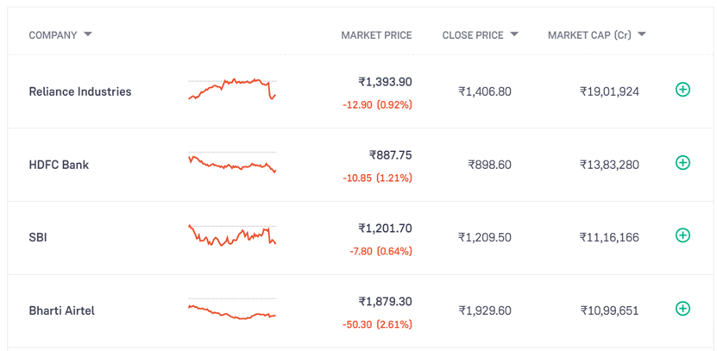
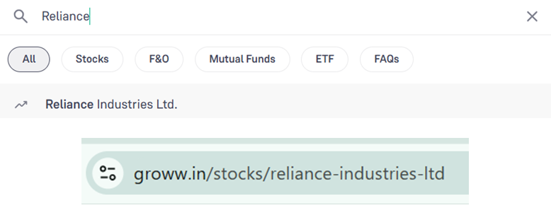
WEB SCRAPING
Initial approach: looped through paginated stock list pages.
Limitation: only surface-level data available.
Shifted to individual company detail pages.
Captured slug changes in URL after company search.
Applied regex to reliably parse company slugs from URLs.
Used Python requests.Session() for persistent connections.

Slide 6
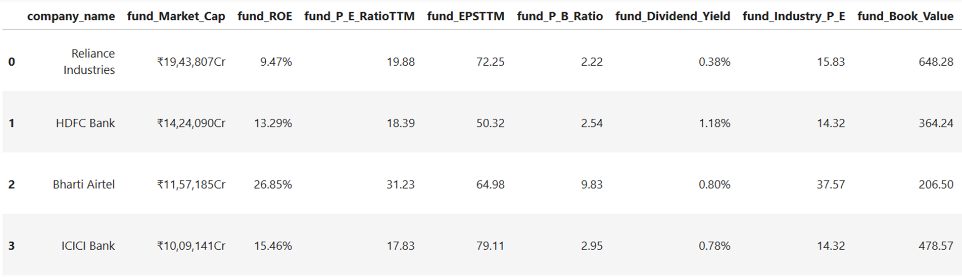
DATA SET
Shape : (13970, 27)

Slide 7

LIBRARIES USED

Slide 8
DATA CLEANING & PREPROCESSING
Data Type Conversion
Converted financial columns to numeric.
Parsed Date column to datetime format.
Text Cleaning
Removed special characters (₹, %, ,) using regex.
Standardized financial values.
Feature Selection
Removed irrelevant columns.
Feature Engineering
Created sector column for industry grouping.
Generated market cap categories (Large/Mid/Small).

Slide 9
DATA CLEANING & PREPROCESSING
Missing Value Handling
Visualized missing values using missingno
Removed rows with no financial information
Imputed remaining missing values using median
Dataset Preparation
Dataset divided into:
1. Fundamentals dataset (long-term financial analysis).
2. Price dataset (short-term market behaviour).
Ensured consistent data types across datasets.

Slide 10
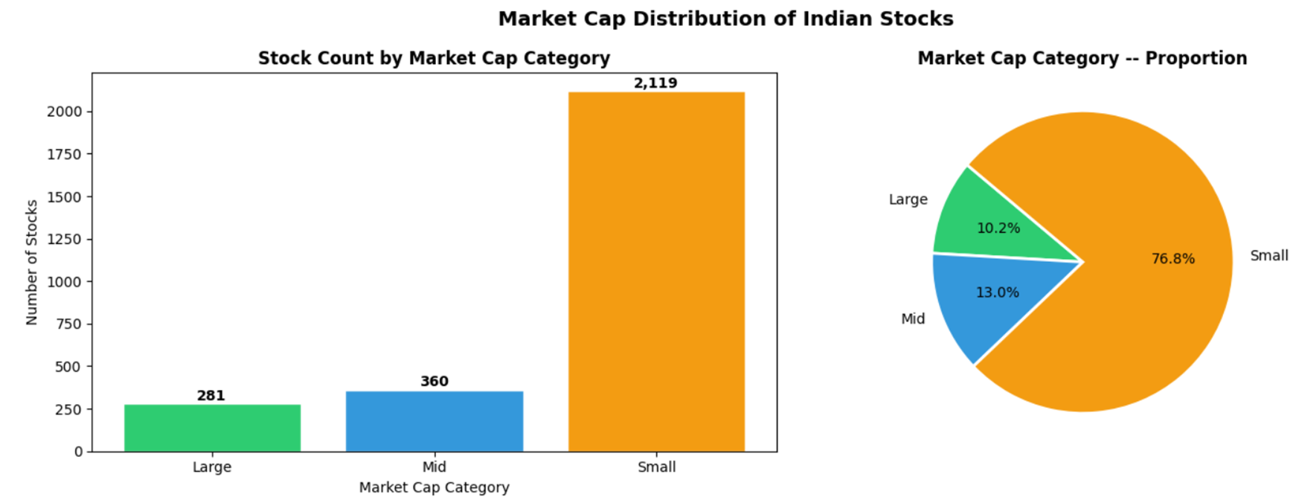
DATA VISUALIZATION
Small Cap stocks dominate (~77%) which is typical for Indian markets.
Most listed companies are small regional businesses.
Large Cap (~10%) represents stable, liquid stocks like Reliance and HDFC.

Slide 11
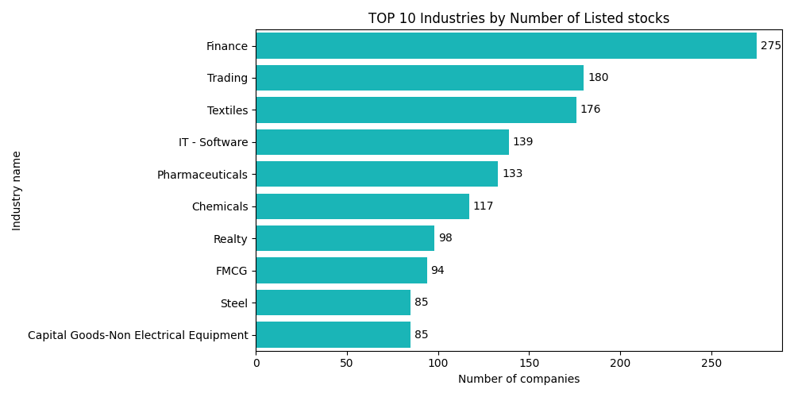
Top 10 industries by number of listed stocks
Finance dominates with the most listed companies, reflecting India's large banking, NBFC and insurance sector.
Textiles and Trading sectors also have high counts, driven by India's manufacturing base and commodity-driven businesses across tier-2 and tier-3 cities.

Slide 12
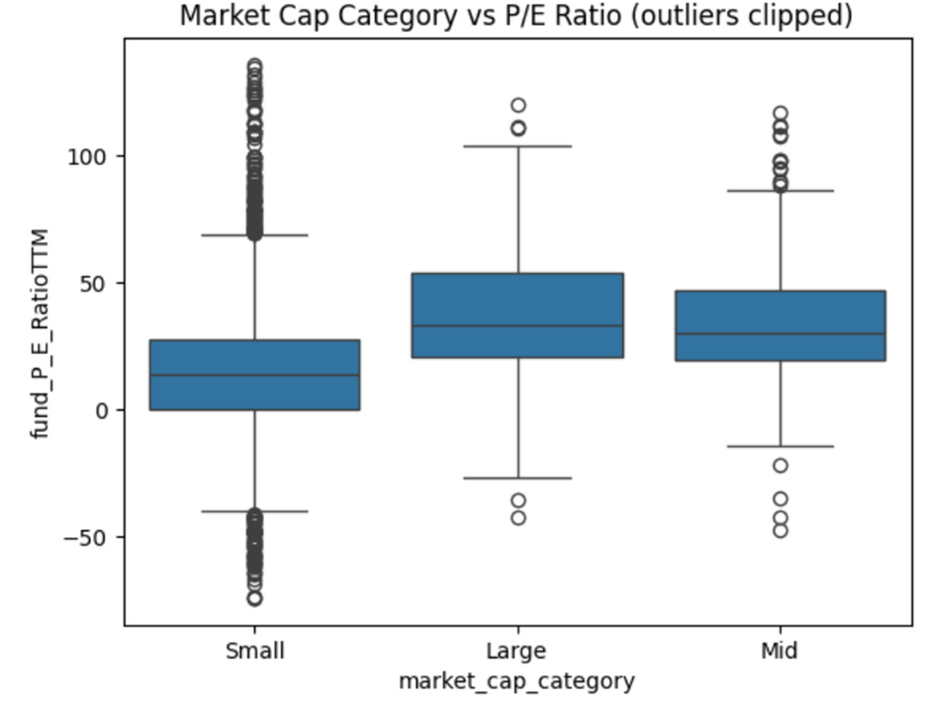
Market cap category vs P/E Ratio
Large and Mid cap stocks are expensive (P/E ~30+) - investors pay a premium for their stability and brand trust.
Small caps are cheap (P/E 13.55) but risky - many are loss-making companies with negative P/E, proving that cheap doesn't always mean a good investment.

Slide 13
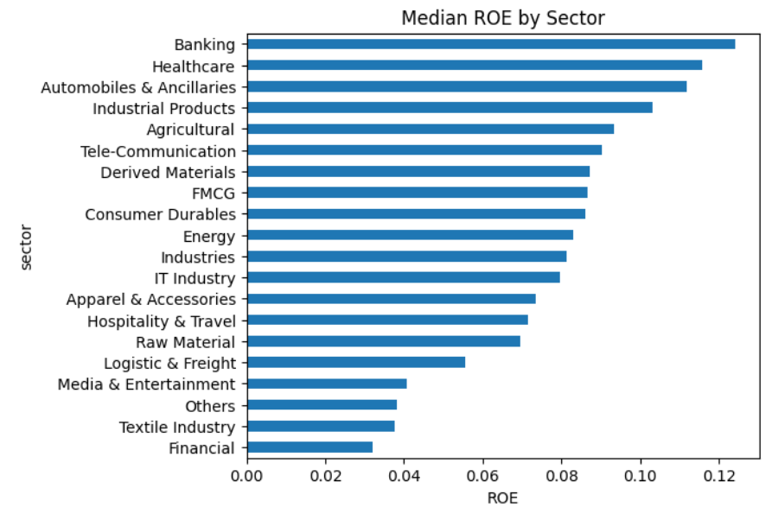
Median ROE by sector
This chart shows the typical profitability of companies within each sector, minimizing distortion from extreme performers.
Banking and Healthcare are the quality sectors - Financial and Textile are the laggards.

Slide 14
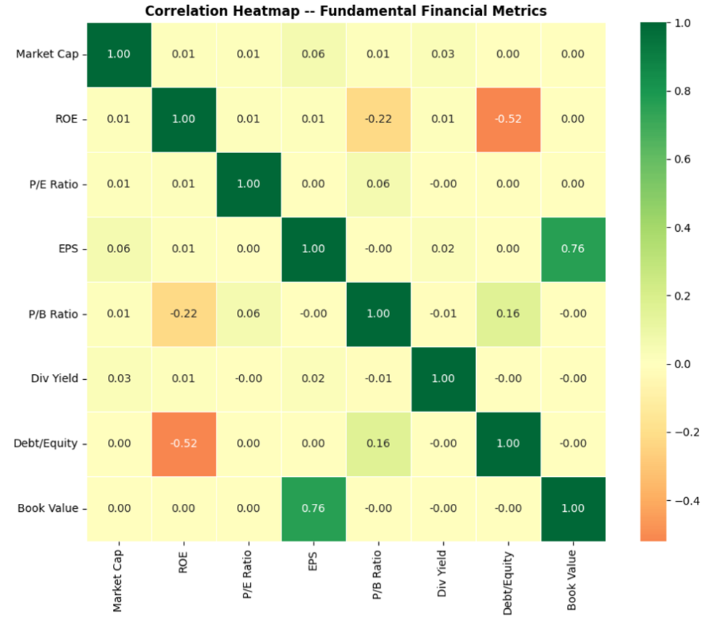
Correlation Heatmap - Fundamental Financial Metrics
1. Strong Positive: EPS vs Book Value (0.76)
Higher earnings per share are strongly associated with higher book value — confirming a fundamental financial relationship.
2. Moderate Negative: ROE vs Debt/Equity (-0.52)
Higher leverage is linked with lower profitability.
In this dataset, increased debt does not enhance returns.
3. Weak Negative: ROE vs P/B Ratio (-0.22)
The market does not strongly reward high-ROE companies with higher valuation premiums.
4. Market Cap Shows No Strong Relationship
Market capitalization has near-zero correlation with key financial metrics — indicating size alone does not explain performance differences.

Slide 15
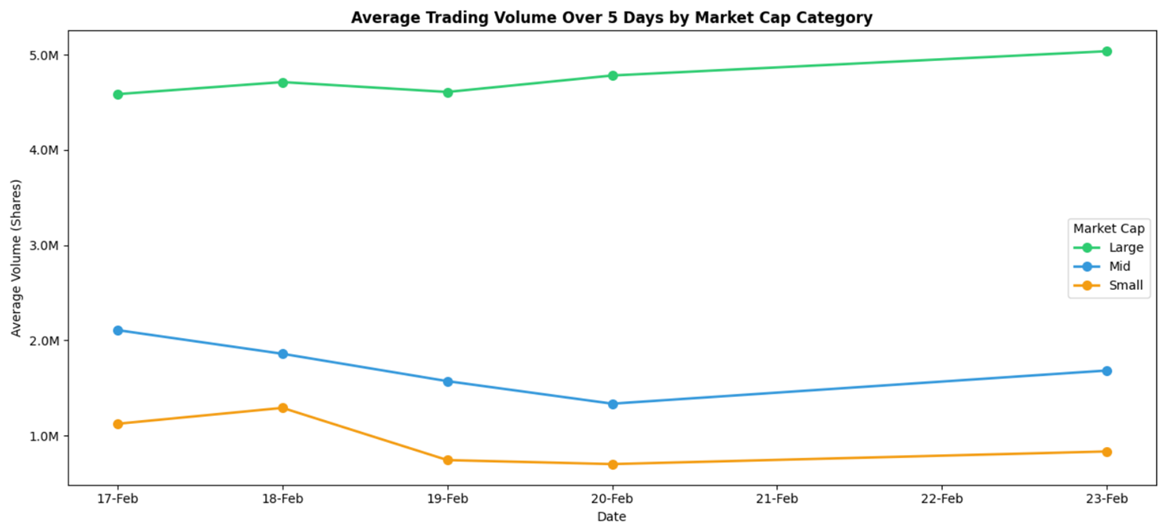
Average Trading volume over 5 days by market cap category
Large-caps led with stable ~4.5-5M shares/day.
Mid-caps saw steady decline then mild recovery.
Small-caps had lowest & most volatile volume.
Trading activity picked up slightly by Feb 23.
Large vs small-cap volume gap widened over 5 days.

Slide 16
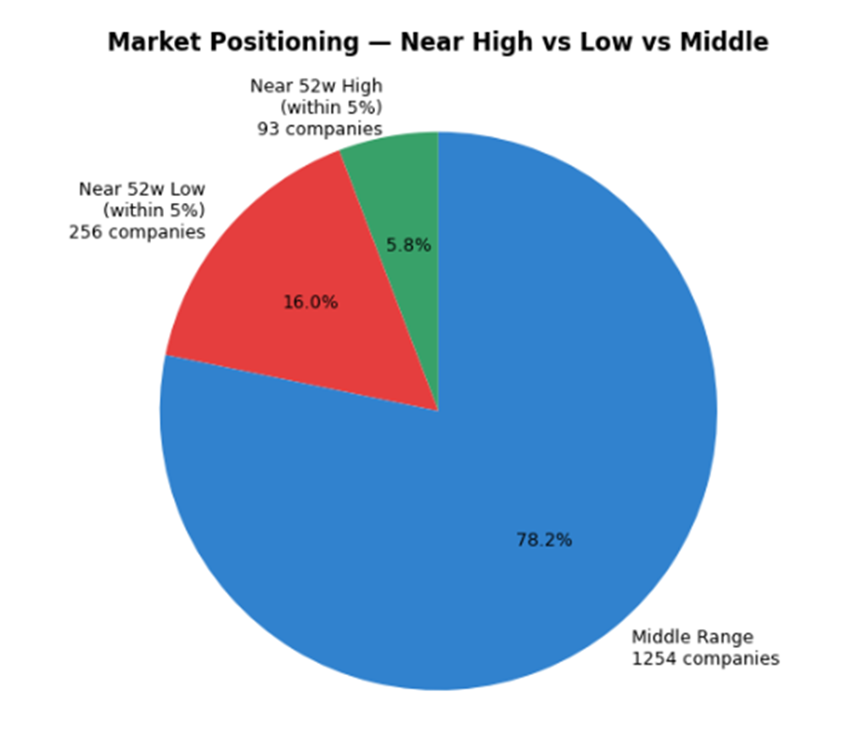
Right now, patience > aggression in most stocks
78.2% stocks in middle range (1,254 companies).
Most stocks are neither near highs nor lows - market in consolidation phase.
Only 5.8% near 52-week highs (93 companies).
Very few stocks showing strong momentum or breakout strength.
16.0% near 52-week lows (256 companies).
More than 2.5× as many stocks close to yearly lows than highs.

Slide 17
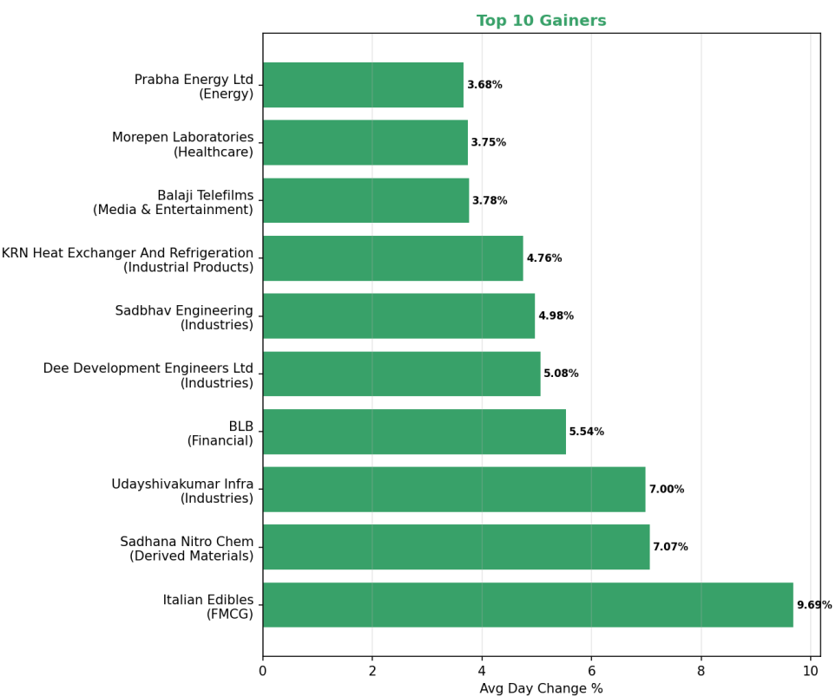
Top 10 Gainers
Industries sector dominates the gainers list (3 companies).
Italian Edibles (FMCG) recorded the highest gain (~9.7%).
Derived Materials sector shows strong momentum (Sadhana Nitro Chem ~7.1%).
Media sector participation seen through Balaji Telefilms (~3.8%).
Gainers span multiple sectors, indicating broad market participation.

Slide 18
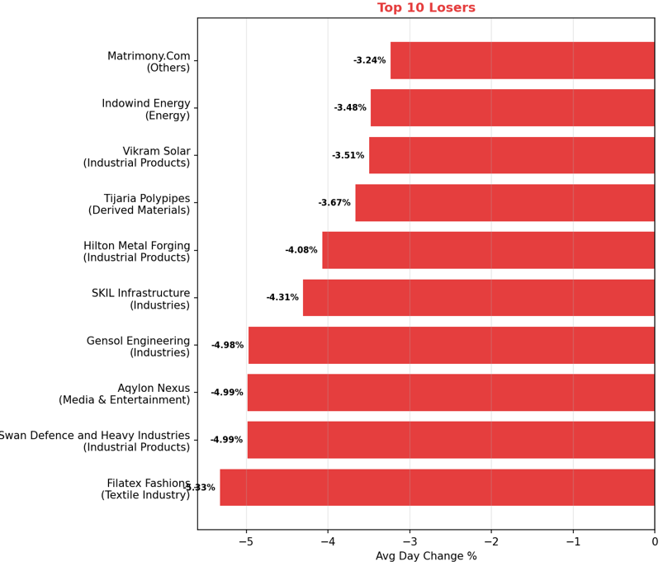
Top 10 Loosers
Industrial Products sector appears multiple times, indicating short-term weakness.
Filatex Fashions (Textile Industry) recorded the largest decline (~-5.3%).
Infrastructure companies show volatility (Gensol Engineering, SKIL Infrastructure).
Renewable energy stocks declined (Indowind Energy, Vikram Solar).
Losses are spread across multiple sectors, suggesting broad market correction.

Slide 19

INSIGHTS
Market shows mixed sentiment with both strong gainers and notable losers.
Infrastructure and industrial companies show strong short-term gains.
Some sectors show higher volatility, indicating active trading.

Slide 20

CONCLUSION
• Large-cap stocks generally trade at higher valuations.
• EPS and Book Value show strong positive correlation.
• Debt levels vary significantly across companies.
• Dividend-paying companies are relatively fewer.
• Market cap influences financial stability and valuation..

Slide 21

THANK YOU

